Slide 1
NATIONAL UNIVERSITY OF PUBLIC SERVICE
FACULTY OF INTERNATIONAL AND EUROPEAN STUDIES
The EU Legal System of the EU
INITB134
Dr. Miklós Szirbik, LL.M.
09.09.2019
INTRODUCTION

Slide 2
Miklós Szirbik, The EU Legal System and the Case Law of the Court of Justice of the EU
Announcement:
Due to organizational reasons the course will be continued next week throughout the semester by Szűcs Anikó Edit - szucs.aniko.edit@uni-nke.hu

Slide 3
Miklós Szirbik, The EU Legal System and the Case Law of the Court of Justice of the EU
Dr. Szirbik Miklós LL.M.
IBS, NKE
Goethe University 2005, Frankfurt am Main
2005 FPS, Frankfurt am Main Europan Law
Andrássy University Budapest 2011
2011 – GIZ
Prime Minister’s Office State Aid Monitoring Office 2012-2016

Slide 4
Miklós Szirbik, The EU Legal System and the Case Law of the Court of Justice of the EU
Introduction into legal systems of the EU
The EU has a legal system and law of its own (sui generis) - the main rules and principles are laid down in the founding Treaties. The EU can adopt legal and legislative acts, which the Member States have to respect and to apply.
Compared to that, other organizations have much less law setting capacities:
Articles 10 and 14 of the UN Charter refer to General Assembly resolutions as "recommendations„ however, they have impact on interpretation of legally binding sources of IPL

Slide 5
Miklós Szirbik, The EU Legal System and the Case Law of the Court of Justice of the EU
Sources of EU law
Questions:
A) How would you define the term source of law?
B) What sources of law do you know in your countries
C) What sources of international law do you know?
D) As a result of the above: which are the sources of EU law?

Slide 6
Miklós Szirbik, The EU Legal System and the Case Law of the Court of Justice of the EU
Sources of EU law
The two main sources of EU law are: primary law and secondary law.
Primary law is constituted by treaties laying down the legal framework of the European Union.
Secondary law is composed of legal instruments based on these treaties, such as regulations, directives, decisions and agreements.
In addition, there are general principles of EU law, the case law developed by the European Court of Justice and international law.

Slide 7
Miklós Szirbik, The EU Legal System and the Case Law of the Court of Justice of the EU
TFEU
CHAPTER 2
LEGAL ACTS OF THE UNION, ADOPTION PROCEDURES AND OTHER PROVISIONS
SECTION 1
THE LEGAL ACTS OF THE UNION
Article 288

Slide 8
Miklós Szirbik, The EU Legal System and the Case Law of the Court of Justice of the EU
Which acts in your national law remind you on the following ones?
Art. 288 TFEU
To exercise the Union's competences, the institutions shall adopt regulations, directives, decisions, recommendations and opinions.
A regulation shall have general application. It shall be binding in its entirety and directly applicable in all Member States.
A directive shall be binding, as to the result to be achieved, upon each Member State to which it is addressed, but shall leave to the national authorities the choice of form and methods.
A decision shall be binding in its entirety. A decision which specifies those to whom it is addressed shall be binding only on them.
Recommendations and opinions shall have no binding force.

Slide 9
Miklós Szirbik, The EU Legal System and the Case Law of the Court of Justice of the EU
Examples:
Regulations - Regulation (EU) 2016/679 of the European Parliament and of the Council of 27 April 2016 on the protection of natural persons with regard to the processing of personal data and on the free movement of such data, and repealing Directive 95/46/EC (General Data Protection Regulation) (Text with EEA relevance)
https://eur-lex.europa.eu/legal-content/EN/TXT/?uri=celex%3A32016R0679

Slide 10
Miklós Szirbik, The EU Legal System and the Case Law of the Court of Justice of the EU
Examples:
Directives - Directive 2014/24/EU of the European Parliament and of the Council of 26 February 2014 on public procurement and repealing Directive 2004/18/EC Text with EEA relevance
https://eur-lex.europa.eu/legal-content/EN/TXT/?uri=celex%3A32014L0024

Slide 11
Miklós Szirbik, The EU Legal System and the Case Law of the Court of Justice of the EU
Examples:
Decisions – (1) Greece Aluminum Case, (2) Poland- Aid scheme for compensation of damage caused by the floods in Poland
http://ec.europa.eu/competition/state_aid/cases/234935/234935_1079057_10_1.pdf
http://ec.europa.eu/competition/state_aid/cases/237314/237314_1142520_25_2.pdf

Slide 12
Miklós Szirbik, The EU Legal System and the Case Law of the Court of Justice of the EU
The Procedure of law setting in the EU
Article 289 TFEU
1. The ordinary legislative procedure shall consist in the joint adoption by the European Parliament and the Council of a regulation, directive or decision on a proposal from the Commission. This procedure is defined in Article 294.
2. In the specific cases provided for by the Treaties, the adoption of a regulation, directive or decision by the European Parliament with the participation of the Council, or by the latter with the participation of the European Parliament, shall constitute a special legislative procedure.
3. Legal acts adopted by legislative procedure shall constitute legislative acts.
4. In the specific cases provided for by the Treaties, legislative acts may be adopted on the initiative of a group of Member States or of the European Parliament, on a recommendation from the European Central Bank or at the request of the Court of Justice or the European Investment Bank.

Slide 13
Miklós Szirbik, The EU Legal System and the Case Law of the Court of Justice of the EU
The Competences of the EU and the MS
CATEGORIES AND AREAS OF UNION COMPETENCE
Article 2 TFEU
1. When the Treaties confer on the Union exclusive competence in a specific area, only the Union may legislate and adopt legally binding acts, the Member States being able to do so themselves only if so empowered by the Union or for the implementation of Union acts.
2. When the Treaties confer on the Union a competence shared with the Member States in a specific area, the Union and the Member States may legislate and adopt legally binding acts in that area. The Member States shall exercise their competence to the extent that the Union has not exercised its competence. The Member States shall again exercise their competence to the extent that the Union has decided to cease exercising its competence.
3. The Member States shall coordinate their economic and employment policies within arrangements as determined by this Treaty, which the Union shall have competence to provide.
4. The Union shall have competence, in accordance with the provisions of the Treaty on European Union, to define and implement a common foreign and security policy, including the progressive framing of a common defence policy.
5. In certain areas and under the conditions laid down in the Treaties, the Union shall have competence to carry out actions to support, coordinate or supplement the actions of the Member States, without thereby superseding their competence in these areas.
Legally binding acts of the Union adopted on the basis of the provisions of the Treaties relating to these areas shall not entail harmonisation of Member States' laws or regulations.
6. The scope of and arrangements for exercising the Union's competences shall be determined by the provisions of the Treaties relating to each area.

Slide 14
Miklós Szirbik, The EU Legal System and the Case Law of the Court of Justice of the EU
The Competences of the EU and the MS
Article 3 TFEU
1. The Union shall have exclusive competence in the following areas:
(a) customs union;
(b) the establishing of the competition rules necessary for the functioning of the internal market;
(c) monetary policy for the Member States whose currency is the euro;
(d) the conservation of marine biological resources under the common fisheries policy;
(e) common commercial policy.
2. The Union shall also have exclusive competence for the conclusion of an international agreement when its conclusion is provided for in a legislative act of the Union or is necessary to enable the Union to exercise its internal competence, or in so far as its conclusion may affect common rules or alter their scope.

Slide 15
Miklós Szirbik, The EU Legal System and the Case Law of the Court of Justice of the EU
Article 4 TFEU
1. The Union shall share competence with the Member States where the Treaties confer on it a competence which does not relate to the areas referred to in Articles 3 and 6.
2. Shared competence between the Union and the Member States applies in the following principal areas:
(a) internal market;
(b) social policy, for the aspects defined in this Treaty;
(c) economic, social and territorial cohesion;
(d) agriculture and fisheries, excluding the conservation of marine biological resources;
(e) environment;
(f) consumer protection;
(g) transport;
(h) trans-European networks;
(i) energy;
(j) area of freedom, security and justice;
(k) common safety concerns in public health matters, for the aspects defined in this Treaty.
3. In the areas of research, technological development and space, the Union shall have competence to carry out activities, in particular to define and implement programmes; however, the exercise of that competence shall not result in Member States being prevented from exercising theirs.
4. In the areas of development cooperation and humanitarian aid, the Union shall have competence to carry out activities and conduct a common policy; however, the exercise of that competence shall not result in Member States being prevented from exercising theirs.

Slide 16
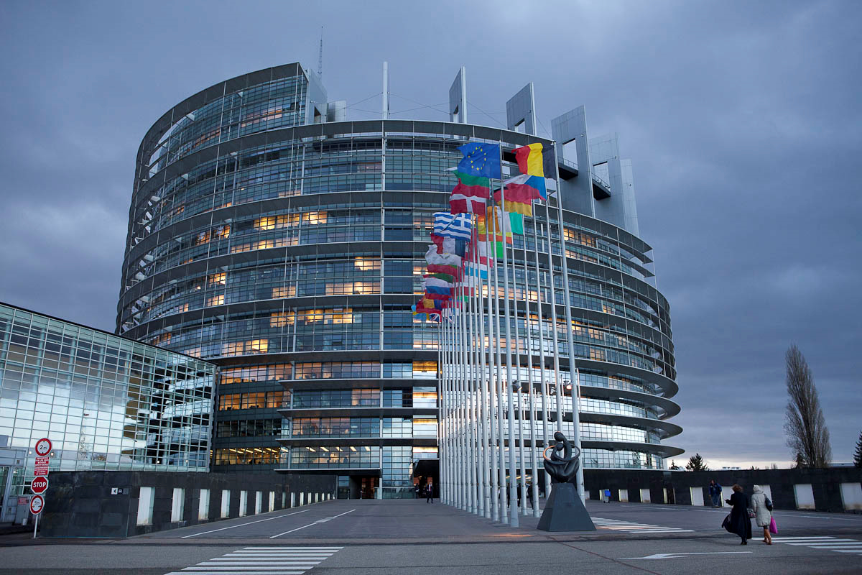
Miklós Szirbik, Public Law of the European Union
The European Parliament

Slide 17
Miklós Szirbik, The EU Legal System and the Case Law of the Court of Justice of the EU
History of EP
1952-1957: Consultative Assembly
Its members were elected by the national parliaments of the MS. As indicated in the name, it had to be heard by the Council while lawsetting but it did not create the itself the European legal sources.
In 1979 shortly after the 1957 Treaties the EP was elected directly for the first time and it broadened its importance continuously. Today it is a co-legislative organ.

Slide 18
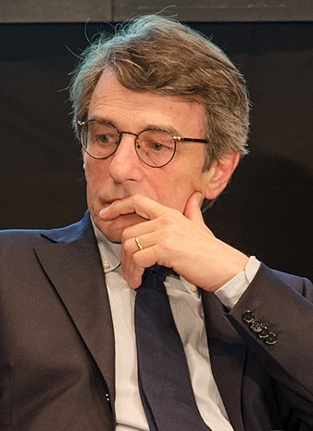
Miklós Szirbik, The EU Legal System and the Case Law of the Court of Justice of the EU
David Sassoli, EPP
since 17 January 2017

Slide 19
Miklós Szirbik, The EU Legal System and the Case Law of the Court of Justice of the EU
European Court of Justice decides in favor of European Parliament in cod case - Case C-124/13
https://eur-lex.europa.eu/legal-content/EN/TXT/?uri=uriserv:OJ.C_.2013.156.01.0021.01.ENG
http://ebcd.org/european-court-of-justice-decides-in-favor-of-european-parliament-in-cod-case/

Slide 20
Miklós Szirbik, The EU Legal System and the Case Law of the Court of Justice of the EU
European Court of Justice decides in favor of European Parliament in - Case C‑73/17 (France v. EP)

Slide 21
Thank you for your attention!

